Slide 1
4.4 The Normal Distribution
A random variable X with density f(x) is said to have normal distribution with parameters μ and σ > 0, where f(x) is given by:
Notes:
1

Slide 6
Mean and Standard deviation for Normal distribution
Theorem: Let X be a normal random variable with parameters μ and σ. Then μ is the mean of X and σ is its standard deviation.
Proof deferred.

Slide 7
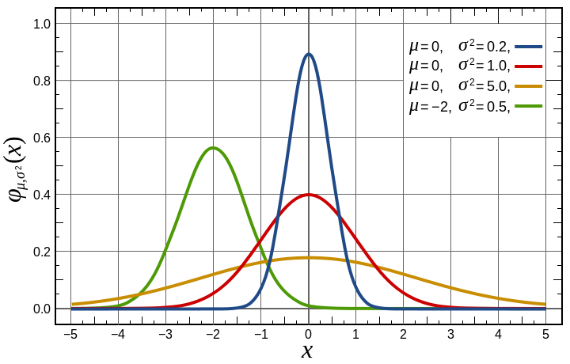
The density Curves

Slide 8
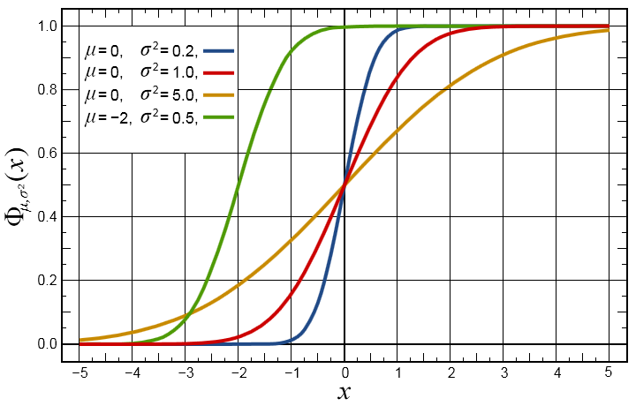
Cumulative Distribution Function

Slide 9
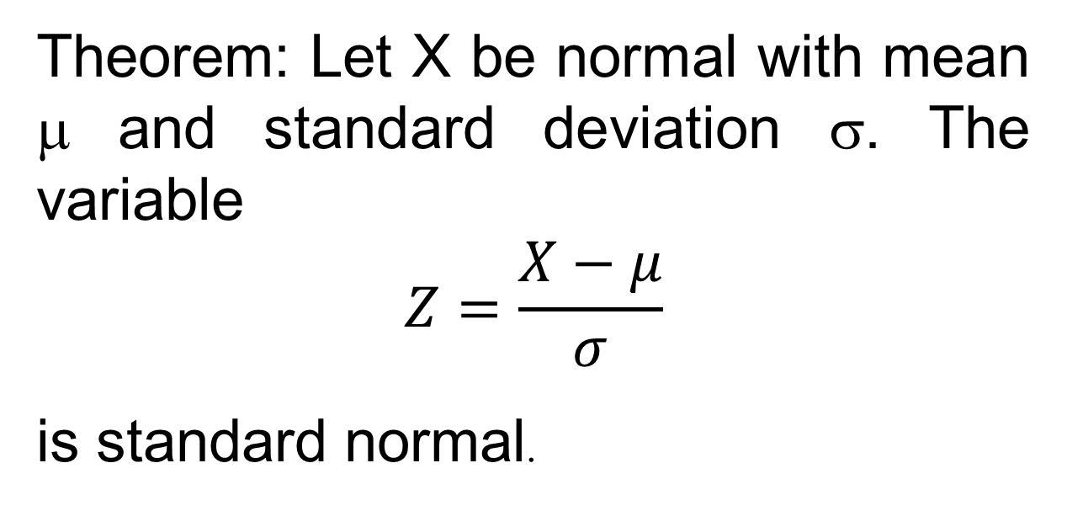
Standard Normal Distribution
A random variable Z is called standard normal
if it is normal and with parameters μ=0, σ=1.

Slide 10
Thus the cdf of (X-μ)/σ is the cdf of standard normal distribution.

Slide 11
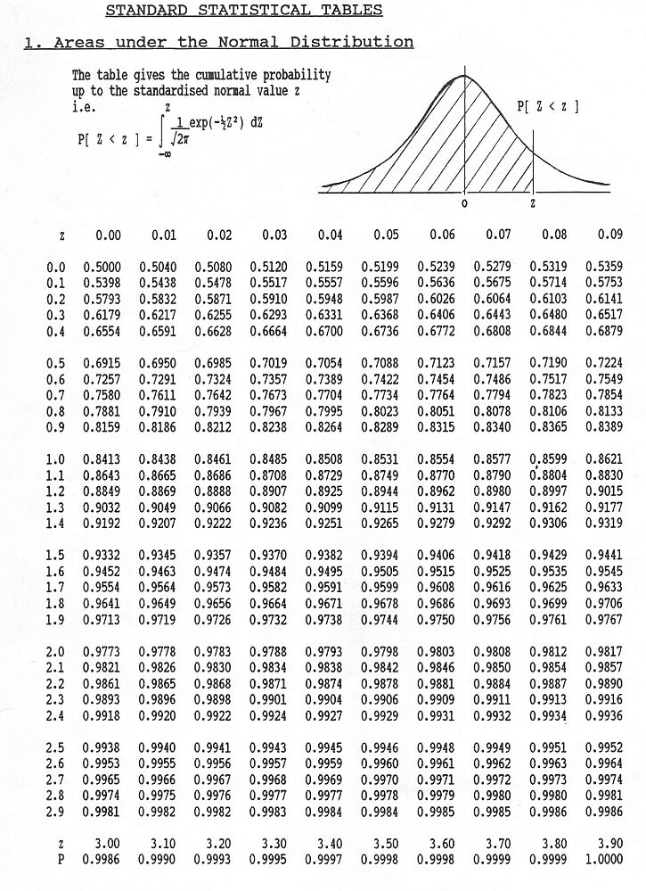

Slide 12
Moment Generating Function

Slide 13
Let z - t = w ⇒ dz = dw

Slide 14
Moment Generating Function
Let Z be normally distributed with parameters μ = 0 and σ = 1, then the moment generating function for Z is

Slide 15
Moment Generating Function
Let X be normally distributed with parameters μ and σ, then the moment generating function for X is given by

Slide 16
Mean and Variance for Normal r.v.

Slide 18
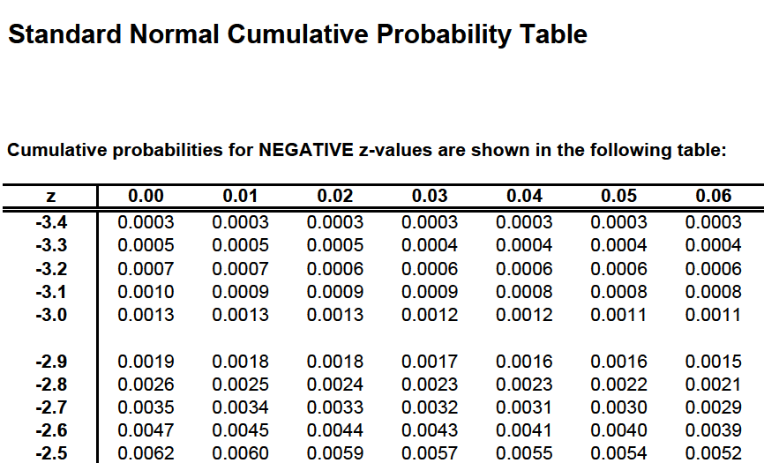

Slide 19
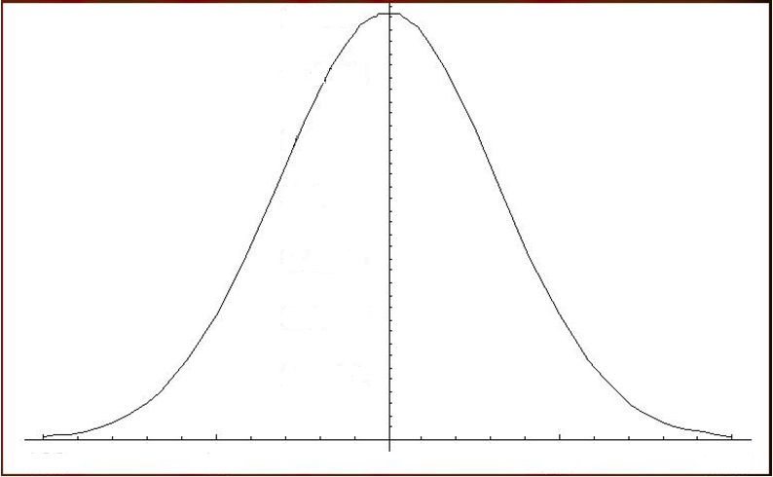

Symmetry
F(2μ-a)=1-F(a).
For standard normal r.v. Z, F_{Z}(-z)= 1 - F_{Z}(z).
a-μ
2μ-a
μ
a

Slide 20
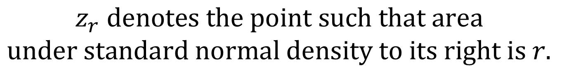



Right Tail Probability
$$z_{r} denotes the point such that area$$
$$under standard normal density to its right is r.$$
$$F_{Z}\left(z_{r}\right)=1−r$$
$$r$$
$$z_{r}$$

Slide 21
Example 39
Using table, find the values of
(v) P[-1.305 ≤ Z ≤ 1.43]
(vi) z _{.10} (vii) z _{.90}
(viii) The point z such that
P(-z ≤ Z ≤ z) = 0.9

Slide 22
(v) P[-1.305 ≤ Z ≤ 1.43]
z
0.00
0.01
0.02
0.03
0.04
1.3
.9032
.9049
.9066
.9082
.9099
1.4
.9207
.9222
.9236
.9251
.9192
P[-1.305 ≤ Z ≤ 1.43] = F(1.43) - F(-1.305)
= 0.9236 – (1 – F(1.305))
= 0.9236 – 1+(0.9032 + 0.9049)/2)
= 0.82765

Slide 23
(vi) z _{.10} (vii) z _{.90}
P(Z ≥ z_{r} ) = r
⇒ P(Z ≥ z_{.10} ) = 0.10
⇒ P(Z < z_{.10} ) = 0.90
⇒ z_{.10} = 1.28
z
0.05
0.06
0.07
0.08
0.09
.8997
.9015
1.2
1.4

Slide 24
(vii) z _{.90} = ?
(viii) The point z such that
P(-z ≤ Z ≤ z) = 0.9
P(-z ≤ Z ≤ z) = F(z) - F(-z)
=2F(z) – 1 = 0.9
i.e. F(z) = 0.95
⇒ z = 1.645
z
0.04
0.05
1.6
0.9495
0.9505
1.4

Slide 25
Example
X is normally distributed and the mean of X is 12 and standard deviation is 4.
(i) Find P(X ≥ 10), P(X ≤ 10), P(0 ≤ X ≤ 12)
(ii) Find r, where P(X > r) = 0.24
(iii) Find a and b, where P(a < X< b) = 0.50
and P(X > b) = 0.25

Slide 26
Find P(X ≥ 10), P(X ≤ 10), P(0 ≤ X ≤ 12)
P(X ≤ 10) = 1 - P(X > 10) = 0.3085

Slide 28
(ii) Find r, where P(X > r) = 0.24

Slide 29
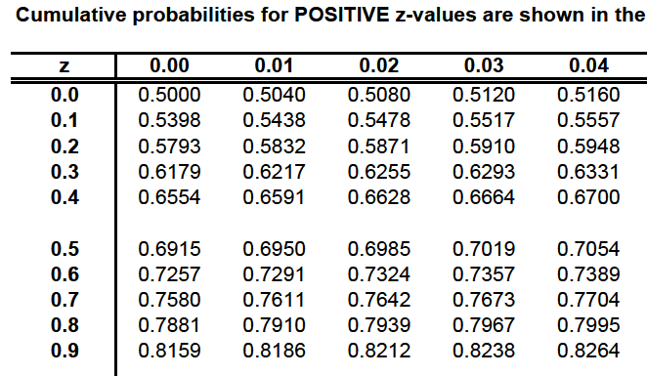
∴r = 0.71 × 4 + 12 = 14.84

Slide 30
(iii) Find a and b,
where P(a < X < b) = 0.50
and P(X > b) = 0.25
Solution:

Slide 31
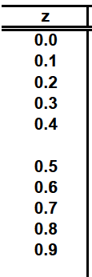
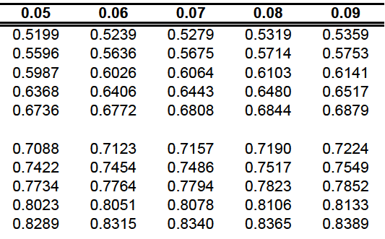
z

Slide 32
Mean = 12, σ = 4, b = ?

Slide 34
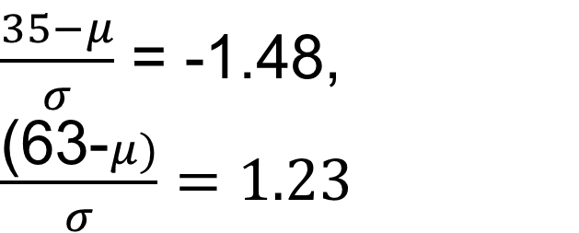
Example
If X is normal random variable with P(X ≤ 35) = 0.07 & P(X ≤ 63) = 0.89
Find mean & standard deviation of X.

Slide 35
Section 4.4, page no 145, 41
Most galaxies take the form of a flatten disc, with the major part of the light coming from this very thin fundamental plane. The degree of flattening differs from galaxy to galaxy. In the Milky Way Galaxy most gases are concentrated near the center of the fundamental plane. Let X denote the perpendicular distance from this center to a gaseous mass. X is normally distributed with mean 0 and standard deviation 100 parsecs. (A parsec is equal to approximately 19.2 trillion miles.)

Slide 36
Sketch a graph of the density for X. Indicate on this graph the probability that a gaseous mass is located within 200 parsecs of the center of the fundamental plane. Find this probability.
Approximately what percentage of the gaseous masses are located more than 250 parsecs from the center of the plane?
What distance has the property that 20% of the gaseous masses are at least this far from the fundamental plane?
What is the moment generating function for X?

Slide 37
b) P[|X| > 250]
a) P[-200 < X<200]
- 500
-250
-200
200
250
500

Slide 38
Log-Normal Distribution
The positive random variable Y is said to have a log-normal distribution, if log_{e}Y is normally distributed with parameters μ and σ.
That is,
X=log_{e}Y is normal
& σ are not mean & standard deviations of Log-normal random variable.

Slide 39
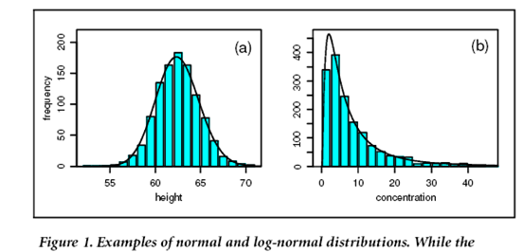

Slide 40
Section 4.4, Problem 45/ p 146
Let X be normal with mean μ and variance σ². Let G denote the cumulative distribution for Y = e^{X} and let F denote the cumulative distribution for X.
Show that (i) G(y) = F(lny), y>0
(ii) G′(y) =F′(lny)/y, y>0
(iii) Find density of Y

Slide 41
i) G(y) = P(Y ≤ y) = P(e^{X} ≤ y) = P(X ≤ ln y) = F(ln y) y>0 G(y)=0, y< 0. ii)

Slide 42
Hence, the density for Y is given by

Slide 43
Problem 46
Let Y denote the diameter in millimeters of styrofoam pellets used in packing. Assume that Y has a log-normal distribution with parameter μ = 0.8, σ = 0.1.
Find the probability that a randomly selected pellet has a diameter that exceeds 2.7 mm
Find two values of Y such that probability is approximately 0.95 between these values?

Slide 44
(i) Find the probability that a randomly selected pellet has a diameter that exceeds 2.7 mm
P(Y > 2.7) =
P(exp(X) > 2.7) = P(X > ln(2.7))

Slide 45
(ii)
P[y₁ < Y < y₂] = 0.95
P(y₁< exp(X) < y₂) = P(ln y₁< X < ln y₂)

Slide 46
0.95
0.025
0.025
z_{0.975}
z_{0.025}

Slide 48
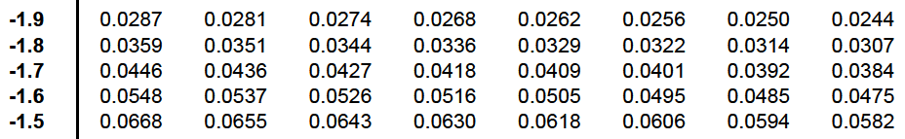

Slide 49
Normal Probability Rule and Chebyshev’s ineqality
It is sometimes useful to have a quick way of determining which values of a random variables are common and which are considered to be rare.

Slide 50
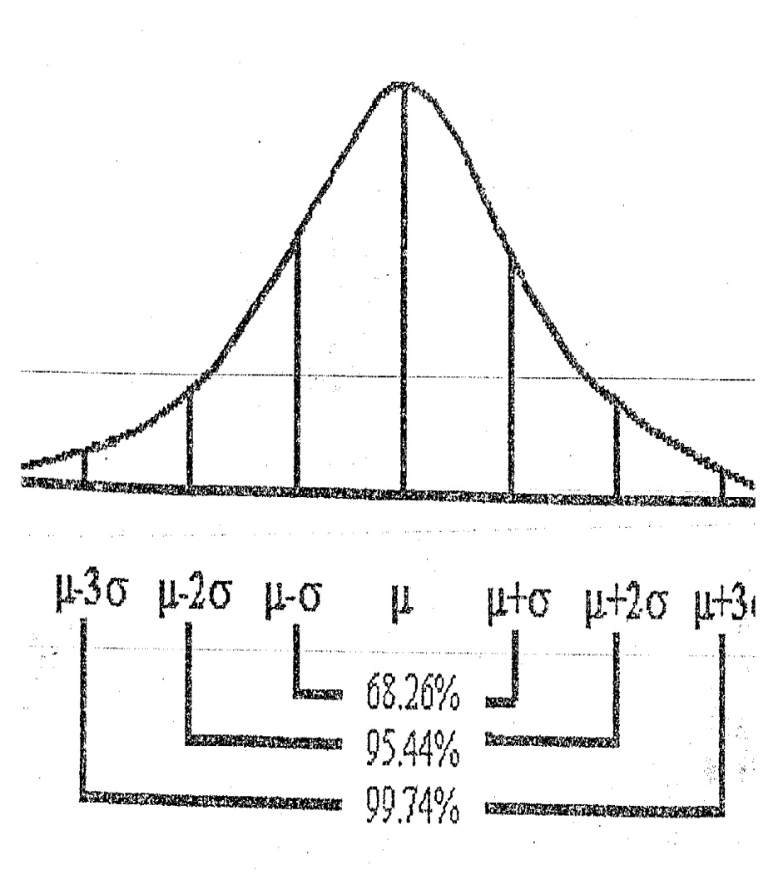
Normal Probability Rule
Let X be normally distributed with parameters mean µ and s.d. σ . Then
P[-σ < X-µ < σ ] ≅ 0.68
P[-2σ < X-µ < 2σ ] ≅ 0.95
P[-3σ < X-µ < 3σ ] ≅ 0.997

Slide 51
Chebyshev’s Inequality
Let X be a random variable with mean μ and standard deviation σ. then for any positive number k,
P[ |X - µ| < kσ] ≥ 1 - 1/k²
P[ |X - µ| ≥ kσ] ≤ 1/k²
where μ is the mean and σ is standard deviation.
Put kσ = ε, then P[ |X - µ| ≥ ε ] ≤ σ²/ε²

Slide 52
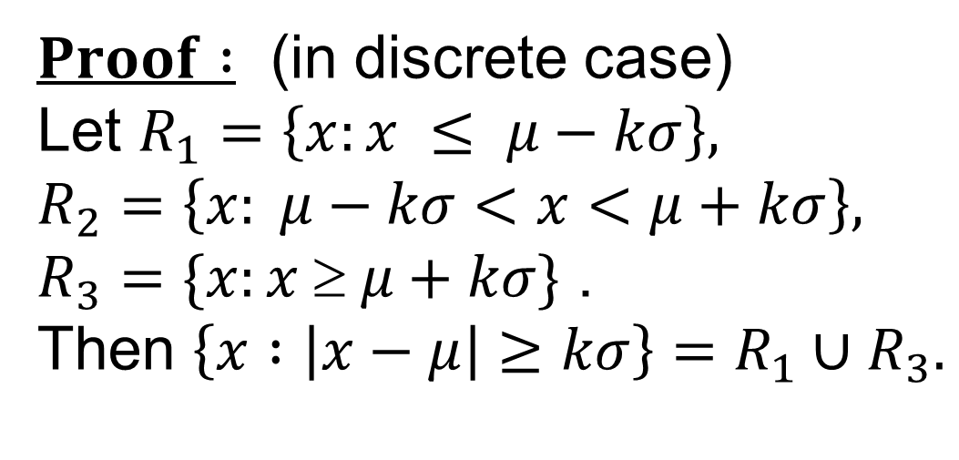











Slide 53
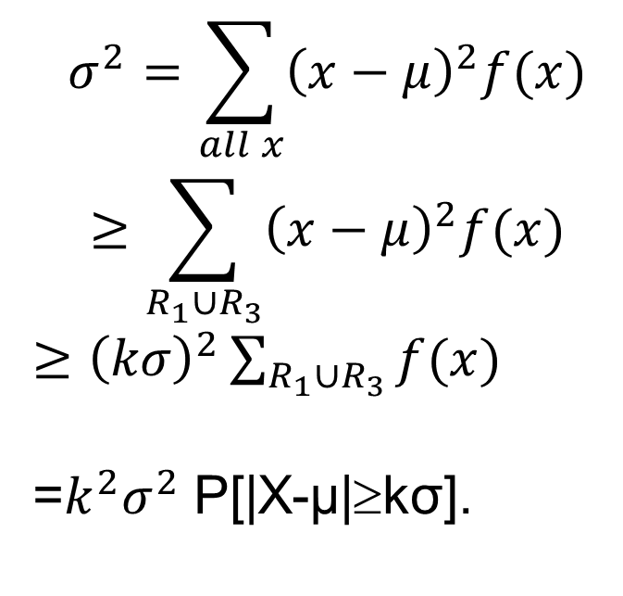


Slide 54
Example
Show, by Chebyshev’s inequality, that in 2000 throws with a coin, the probability that the number of heads lies between 900 and 1100 is at least 19/20. (900 and 1100 not included)
Solution: Let X be the number of heads (successes) in throwing of a coin, then
X ~ Bin(n,p), where n = 2000, p = 1/2.
E(X) = np = 1000, Var(X) = npq = 500.

Slide 55
To find a lower bound for
By Chebyshev’s theorem,
(1)

Slide 56
Letting

Slide 57
Find the bound on probability if 900 & 1100 are included?

Slide 58
Example
From a usual pack of 52 cards, cards are drawn randomly with replacement till the red card appears. If X denotes the number of card drawn, using Chebyshev’s inequality, find a lower bound for P[I X - 2 I < 2].

Slide 59
Example
If X is Gamma random variable with α = 0.05 & β = 100 find an upper bound on
P([(X-4)(X-6)] ≥ 999).

Slide 60
Exercise
How many times should we toss a balanced coin so that we can assert with probability at least 0.99 that the proportion of heads occurs between 0.45 and 0.55?

Slide 61
Solution : Let n be number of trials.
Now on each trial, p = probability of head = 0.5.
X = number of heads in n trials.
X has binomial distribution with parameters n and p=0.5, thus μ=n/2 and σ²=n/4.

Slide 62
Proportion of heads =X/n is between 0.45 and 0.55
if and only if 0.45n < X < 0.55n. (*)
Since X has binomial dist. With p=1/2,
μ=0.5n.
Thus (*) is equivalent to |X- μ| < 0.05n.

Slide 63
The required probability = P(|X-μ| < 0.05n)
which will be at least 1 –1/k²
where kσ =k n^{1/2}/2 =0.05n.
This gives k=0.1 n^{1/2}.
Thus if we choose n such that
1 –1/k² = 1- 100/n > 0.99
then we get what was desired.
Now if n > 10000, then this condition is satisfied.

Slide 64
This justifies the relative frequency approach
to the probability. The proportion of successes
(i.e. relative freq) can be brought as close to
the actual probability by increasing the number
of trials.

Slide 65
Example
In one out of 6 cases, material for bulletproof vests fails to meet puncture standards. If 405 specimens are tested, what does Chebyshev’s theorem tell us about the probability of getting at most 30 or more than105 cases that do not meet puncture standards?

Slide 66
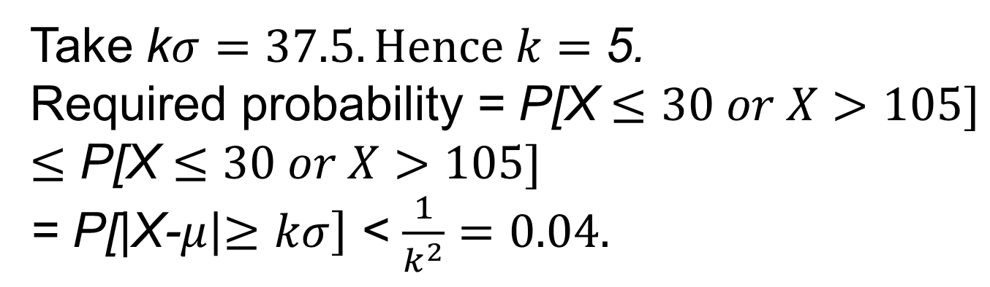
X = number of bulletproof vests out of 405
which fail to meet puncture standards.
X has binomial distribution with n = 405, p =1/6.
μ= 405/6 = 67.5, σ = √((67.5)5/6) = 7.5.

Slide 67
Question 4.5.50,pg.147
For a normal distribution P[|X-µ| < 3σ] = 0.997. What value is associated to this probability via Chebyshev’s inequality? Are the results consistent? Which rule gives a stronger statement in case of a normal variable?

Slide 68
Normal Approximation to the Binomial Distribution
If X is Binomial with parameters n & p for large n
Remark: For practical purposes approximation is acceptable for values of n & p such that
[p ≤ 0.5 & np > 5] or [p > 0.5 & n(1-p) > 5]

Slide 69
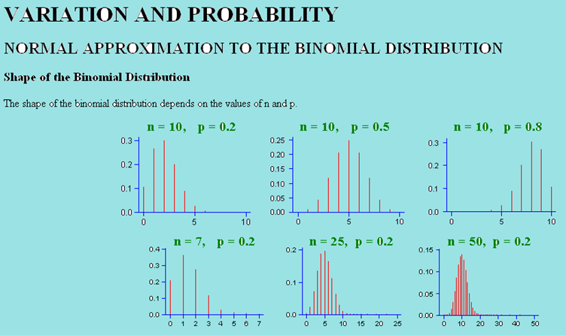

Slide 70
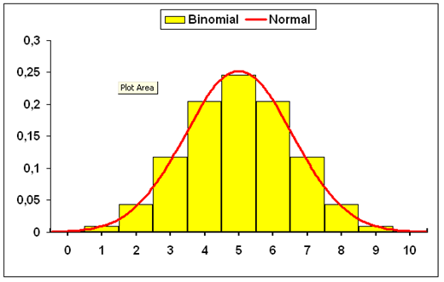

Slide 71
Half unit Correction (for continuity)
For integers a, b between 0 and n,
1. P(X = a) = P(a - 0.5 < X* < a + 0.5)
2. P(X ≤ b) = P(-∞ < X ≤ b)
= P(X *≤ b + 0.5)
3. P(X ≥ a) = P(a ≤ X < ∞)
= P(a - 0.5 ≤ X* < ∞)=P( X* ≥ a - 0.5)
4. P(a ≤ X ≤ b) = P(a - 0.5 ≤ X* ≤ b + 0.5)

Slide 72
Example
Let X be binomial with n = 20 and p = 0.3. Use the normal approximation to each of the following. Compare the results with values obtained from Table I of App. A
(i) P[X ≤ 3] (ii) P[3≤ X ≤ 8]
(iii) P[X ≥ 4] (iv) P[X = 4]

Slide 73
(ii) P[3≤ X ≤ 8]

Slide 74
53. Although errors are likely when taking measurements from photographic images, these errors are often very small. For sharp images with negligible distortion, errors in measuring distances are often no larger then 0.0004 inch. Assume that the probability of a serious measurement error is 0.05. A series of 150 independent measurements are made. Let X denote the number of serious errors made.

Slide 75
(i) In finding the probability of making at least one serious error, is the normal approximation appropriate? If so, approximate the probability using this method.
(ii) Approximate the probability that at most three serious errors will be made.

Slide 76
(i) In finding the probability of making at least one serious error, is the normal approximation appropriate? If so, approximate the probability using this method.
p = 0.05, n = 150 i.e. p ≤ 0.5
& np = (150)(5)/100 = 7.5 > 5
i.e. Normal approximation is appropriate

Slide 77
Let X* be a normal random variable with parameters np and √(npq).

Slide 78
(ii) Approximate the probability that at most three serious errors will be made.

Slide 79
Normal Approximation to the Poisson Distribution
Let X be Poisson with parameter λs.
Then for large values of λs, X is approximately normal with mean λs and variance λs.

Slide 80
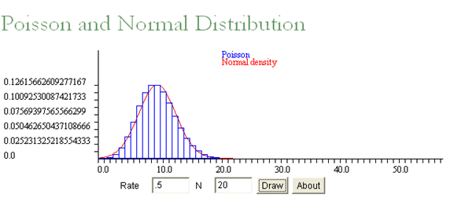

Slide 81
12 The average number of jets either arriving at or departing from O’Hare Airport is one every 40 seconds.
What is the approximate probability that at least 75 such flights will occur during a randomly selected hour?

Slide 82
λ = 1 for unit of 40 sec. But interval has length one hour i.e. 3600 sec. Thus s = 3600/40, hence parameter λs = 90

Slide 83
Example
Show, by Chebyshev’s inequality, that in 2000 throws with a coin, the probability that the number of heads lies between 900 and 1100 is at least 19/20. (900 and 1100 not included)
Solution: Let X be the number of heads (successes) in throwing of a coin, then
X ~ Bin(n,p), where n = 2000, p = 1/2.
E(X) = np = 1000, Var(X) = npq = 500.

